Slide 1
How Much Does Renewable Energy Really Cost?
Impacts of a National Renewable Energy Standard
Steve Clemmer
Senior Energy Analyst
Union of Concerned Scientists
http://www.ucsusa.org
sclemmer@ucsusa.org
NEMS 2002 Conference
Washington, DC
March 12, 2002

Slide 2
Approach
Used modified version of NEMS developed for AEO 2001
Identified modeling issues as reviewer on EIA RPS and power plant multi-pollutant reduction reports
Identified and made changes to certain renewable energy assumptions based on input from renewable energy experts familiar with NEMS and previous work
  including DOE, NREL, ORNL, LBL, consultants
Analyzed national renewable energy standard proposals and other clean energy policies

Slide 3
Key Renewable Energy Constraints in NEMS
Growth rate constraints
  0.5% increase in capital cost for every 1% increase in annual growth rate above 30%
Long-term capital cost multipliers to reflect additional costs of resource degradation, transmission network upgrades, and market factors.
Regional annual build limits for certain resources
Cap on regional penetration of variable output resources (wind and solar) of 15%
Limits on building in one region to serve another
Biomass cofiring in coal plants limited to 5%

Slide 4
General technology assumptions
Model modifications - policy cases only
Replaced EIA’s pessimistic cost and performance assumptions for renewable energy technologies
Used assumptions consistent with the EPRI/DOE and Clean Energy Future Studies
  except for higher initial capital costs for wind and reduced NEMS site-specific capital costs for geothermal
Costs are lower than EIAs for all renewable technologies except biomass gasification
Capital costs hard-wired instead of using EIAs learning function that lowers costs as domestic capacity increases
Notes:
Bullet 1 Notes: CEF study, which assumed EPRI/DOE projections will be achieved through increased R&D funding together with industry learning, growth in domestic capacity that occurs under our renewables policy package, and growth in international capacity. Cadogan and Brower claim EIA’s learning function underestimates cost reductions from growth in international capacity and R&D and likely overestimates cost reductions due to growth in domestic capacity.

Slide 5
Wind
Model modifications
Regional penetration constraint raised from 15% to 30%
  Regions in Germany, Denmark and Spain over 20%
Reclassified windy land area in each region to account for additional siting constraints as more wind is developed
  35% reduction in mountainous region potential
  17% reduction in other regions
  Original data already excludes 100% of urban and environmentally sensitive land, 50% of forested land, 30% of ag land, 10% of rangeland, and land further than 20 miles from existing transmission lines
Replaced EIA regional capital cost multipliers of up to 3x with maximum increase of 40%
  Included cost of backup power from natural gas CT when regional wind penetration >10%; max. increase of 20% when penetration >20%
  Additional 20% cost increase as best sites are used based on CEF study
  Extra transmission costs already included for wind
Notes:
Basis for bullet 2: CEF study; wind is already providing more than 20% of the electricity used in parts of Denmark, Germany, and Spain; supported by Brower, Cadogan, and Short; Caldwell and Olsen think its too conservative; studies in Europe show actual penetrations above 20% have been achieved at little cost and with little impact to the system.
Basis for bullet 4: CEF claims no empirical evidence of penalties above 20%; contrary to historical experience; EIA assumptions are based on limited, outdated and misinterpreted studies from the Northwest, CA and MN; no evidence of these penalties in recent projects proposed in California. Windy land area reductions are half of what we assumed in our 1999 study based on a reevaluation of the study EIA uses from the Northwest and because class 3 wind resources, which could become economic in the future, are not included in NEMS.

Slide 6
EIA’s Wind Capital Cost Multipliers
2,500
2,223
90% of total US class 4-6 wind resource faces highest cost penalty
2,000
1,500
Gigawatts
1,000
500
28
41
81
88
0
1
1.2
1.5
2
3
Wind Capital Cost Multiplier
Source: EIA, “Modeling Costs of U.S. Wind Supply,” Issues in Midterm Analysis and Forecasting, 1999.

Slide 7
Biomass
Model modifications
Increased cofiring from a max of 5% per region with no capital costs to up to 10% with capital costs of $200/kW
Removed regional capital cost multipliers of up to 100% for new gasification plants as more biomass is used
Reduced forestry residues by half to provide extra margin against using unsustainable sources
Excluded 5 percent of C&D debris, on top of existing 75% exclusion, to provide extra margin against using contaminated materials
Removed regional annual build limits
Notes:
Basis for bullet 1: Actual experience from around the world (e.g. Denmark) has shown a typical size coal plant can cofire up to 15% biomass, with minimal impacts on plant efficiency and resource limits within a 50-100 mile radius around the plant. CEF assumed 5%, but authors acknowledge this was overly conservative.
Basis for bullet 2: No empirical basis or documented explanation by EIA; fuel supply curves take into account increasing costs; more flexibility in siting plants closer to transmission lines.

Slide 8
Geothermal
Model modifications
Removed site specific capital cost multipliers as successive amounts of the resource is developed
Reduced capital costs for power plants by 25%, field costs by 12%, and drilling costs by 15% to reflect current technology.
  Source: Dan Entingh, PERI.
Notes:
Basis for bullet 1: Expert input from Dan Entingh, PERI, co-author of the EPRI/DOE study and the study EIA uses for the site-specific data, who claims EIA’s assumptions are based on late 1980s technology. Drilling and other exploration costs for successive developments at an already developed field can actually be lower than initial costs based on a better understanding of the field.
Basis for bullet 2: Recent EIA revisions to NEMS; recommendation from Dan Entingh.
Basis for bullet 3: CEF study; duplicated by NEMS short-term capital cost multipliers; has little impact on results because not enough new solar and biomass capacity is added.

Slide 9
Unchanged EIA conservative assumptions
EIA underestimates potential contribution of state renewables policies
  UCS: 12,700 MW of new renewables by 2012 vs. EIA 7,500 MW by 2020
No extension/expansion of the federal Production Tax Credit
  More renewable planned additions would likely lower the cost of meeting the RPS
EIA limits renewables that can be built in one region to serve another
  constrains wind development in the Plains states
EIA excludes class 3 wind resources
  constrains potential future wind development in eastern US
EIA reduced geothermal technical potential by over 40%
EIA underestimates future volatility in natural gas prices
No growth rate or siting penalties applied to new gas & coal plants

Slide 10
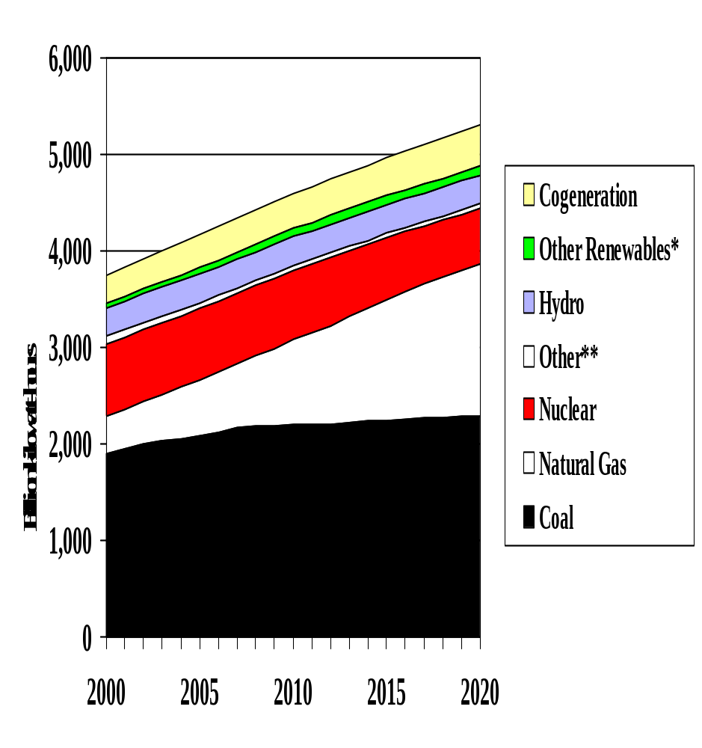
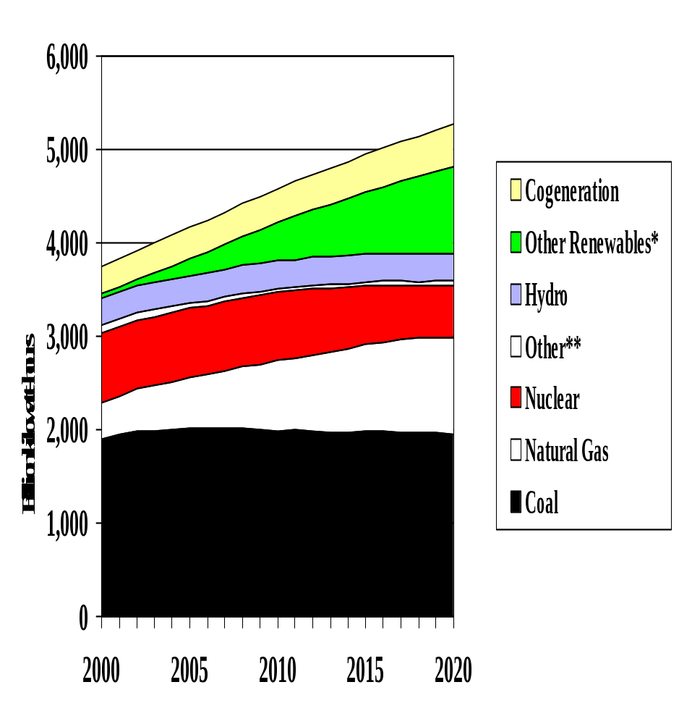
UCS: Impact of 20% RPS on electricity mix
Business as Usual
RPS - 20% by 2020
*Includes wind, solar, geothermal, biomass, and landfill gas.
**Includes oil, municipal solid waste, and other wastes.
Source: UCS, Renewing Where We Live, 2002

Slide 11
Renewable Energy Mix in 2020 under 20% RPS
UCS
EIA
Solar
Landfill Gas
Solar
Landfill
2%
5%
Geothermal
0.4%
Gas
Geothermal
2%
12%
12%
Biomass
41%
Wind
Biomass
28%
58%
Wind
40%
Sources: UCS, Renewing Where We Live, 2002 EIA, Strategies for Reducing Multiple Emissions from Electric Power Plants, July 2001

Slide 12
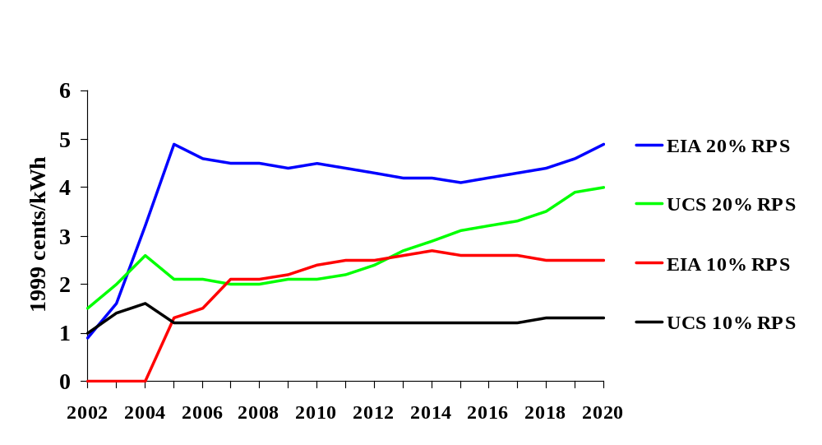
Renewable Energy
Credit Prices
Source: UCS, Renewing Where We Live, 2002;EIA, Strategies for Reducing Multiple Emissions from Electric Power Plants, July 2001

Slide 13
EIA overstates electricity production cost increase of RPS
EIA claims 20% RPS by 2020 would increase electricity production costs by $118 billion over next 18 years
Costs are not discounted
Includes 100% of capital cost in year plants are built. Costs should be annualized over 20-30 year period to be consistent with annual fuel cost reductions
Doesn’t include additional fossil fuel savings after 2020
RPS reduces windfall profits to coal and gas plants
Impact on consumer costs more important

Slide 14
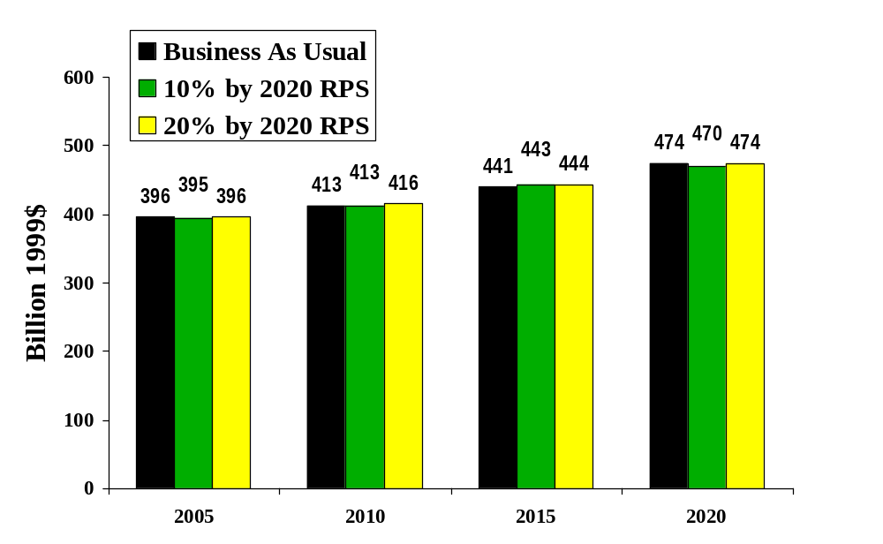
EIA: RPS is Affordable
Total Consumer Energy Bills (excluding transportation)
Source: EIA, Strategies for Reducing Multiple Emissions from Electric Power Plants, July 2001, Table E3.

Slide 15
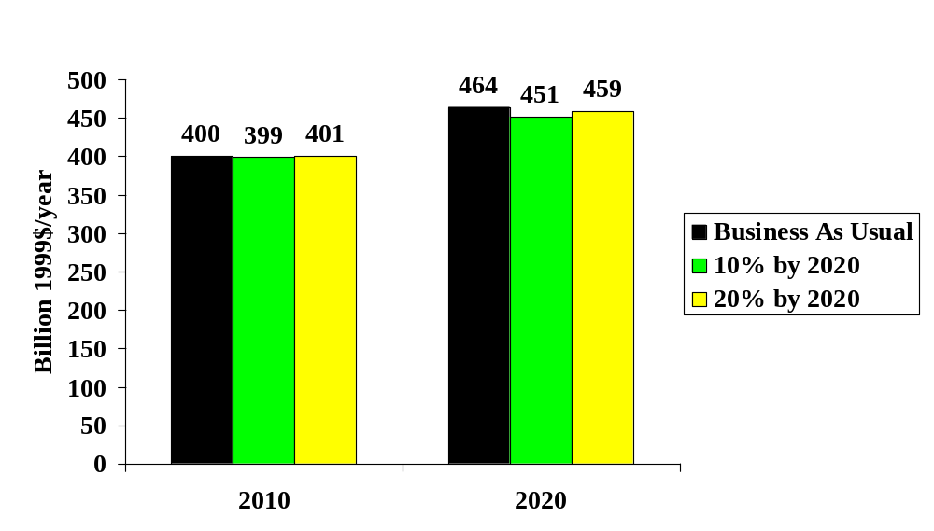
UCS: RPS is Affordable
Total Consumer Energy Bills (excluding transportation)
Source: UCS, Renewing Where We Live, 2002

Slide 16
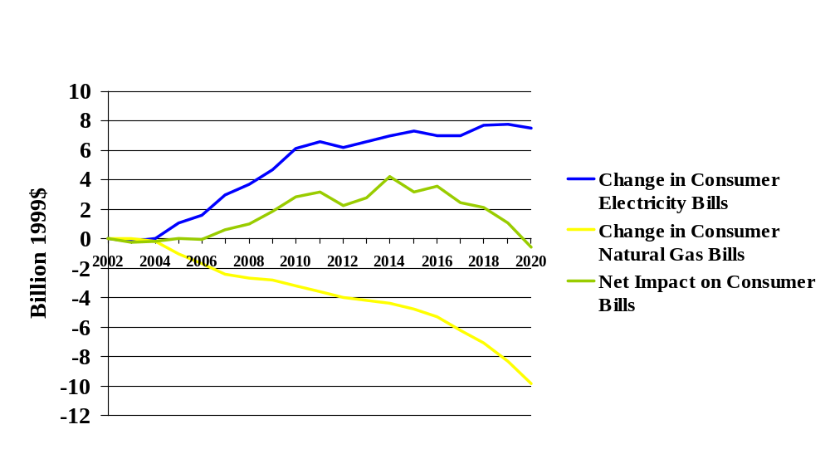
EIA: Change in Consumer Energy Bills Under 20% RPS
Source: EIA, Strategies for Reducing Multiple Emissions from Electric Power Plants, July 2001, Tables E2 and E3, not including refinery energy consumption or transportation.

Slide 17
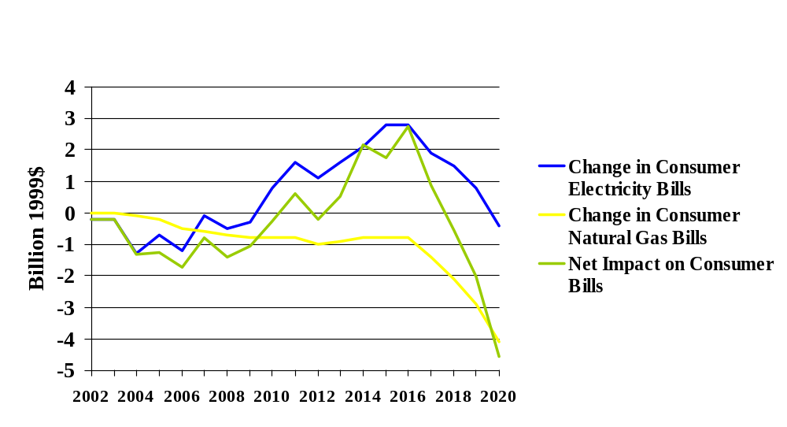
EIA: Change in Consumer Energy Bills Under 10% RPS
Source: EIA, Strategies for Reducing Multiple Emissions from Electric Power Plants, July 2001, Tables E2 and E3, not including refinery energy consumption or transportation.

Slide 18
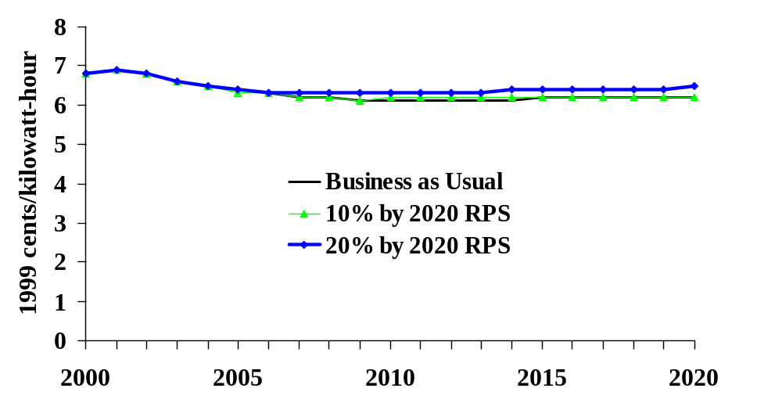
EIA: Average Consumer Electricity Prices Slightly Higher under RPS
Source: EIA, Strategies for Reducing Multiple Emissions from Electric Power Plants, July 2001.

Slide 19
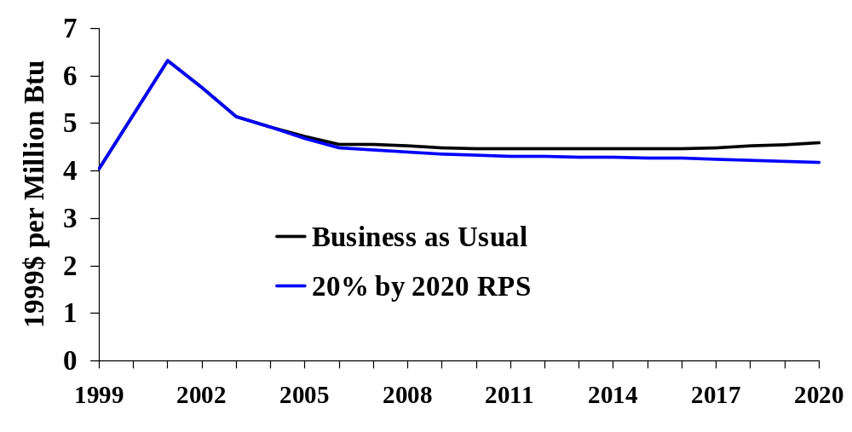
EIA: Average Consumer Natural Gas Prices Lower under RPS
Source: EIA, Strategies for Reducing Multiple Emissions from Electric Power Plants, July 2001, Table E3.

Slide 20
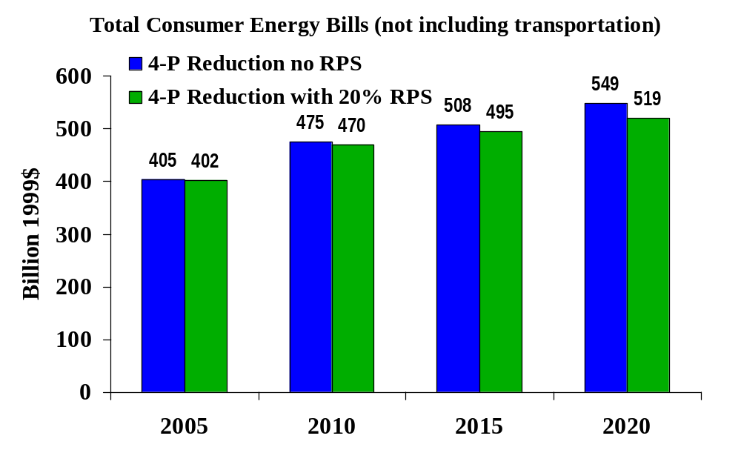
EIA: RPS Lowers Cost of
4-Pollutant Reductions
Source: EIA, Strategies for Reducing Multiple Emissions from Electric Power Plants, July 2001, Table H3.

Slide 21
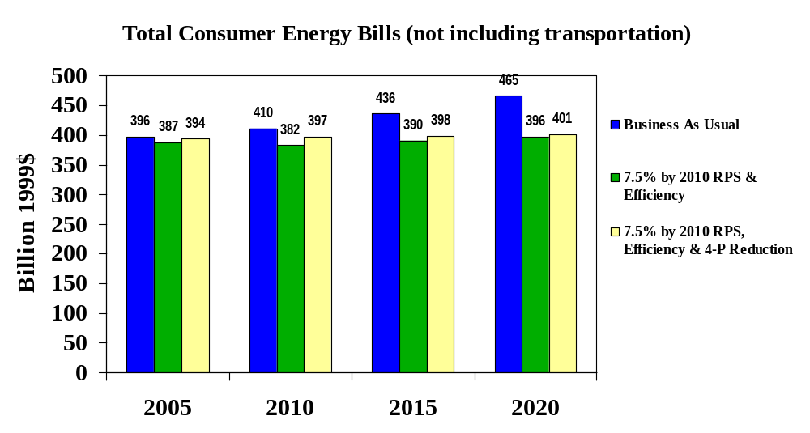
EIA: Combining 4 Pollutant Reductions with an RPS and Efficiency Saves Money
Source: EIA, Strategies for Reducing Multiple Emissions from Electric Power Plants with Advanced Technology Scenarios, Oct. 2001, Table D3.

Slide 22
UCS: Combining a 20% RPS with Efficiency Increases Savings
Clean Energy Blueprint
Net savings reach $105 billion per year in 2020
200
180
160
Incremental Costs
140
Energy Bill Savings
120
Cumulative savings = $440 billion
Billion 1999$
100
80
60
40
20
0
2002
2004
2006
2008
2010
2012
2014
2016
2018
2020

Slide 23
UCS: Renewing Where We Live
Benefits of 20% RPS
Employment
  $80 billion in new investment
  $5 billion in property tax revenues for communities
  $1.2 billion in new income for farmers
  > 80,000 new jobs
Environment
  19% CO₂ reductions by 2020 compared to BAU
  ~ 100 million metric tonnes
  Reduction in Nox, Sox, particulates, mercury
Consumers
  Reduce fossil fuel dependence, price volatility, costs
  $4.8 billion energy bill savings through 2020

Slide 24
Conclusions
EIA/NEMS overstates the costs of increasing renewable energy use
A national RPS is affordable, even using EIAs pessimistic renewable energy assumptions
A RPS provides important energy diversity, security, environmental and rural economic benefits not fully captured by energy markets
National RPS is needed to capture these national benefits

